Slide 1
U.S. Jobs Market – July Update
Sign up for our free service at https://publicinsight.io/research/us-jobs-report/.
August 18, 2023
Dan Quigg — CEO, Public Insight Data Corporation

Slide 2
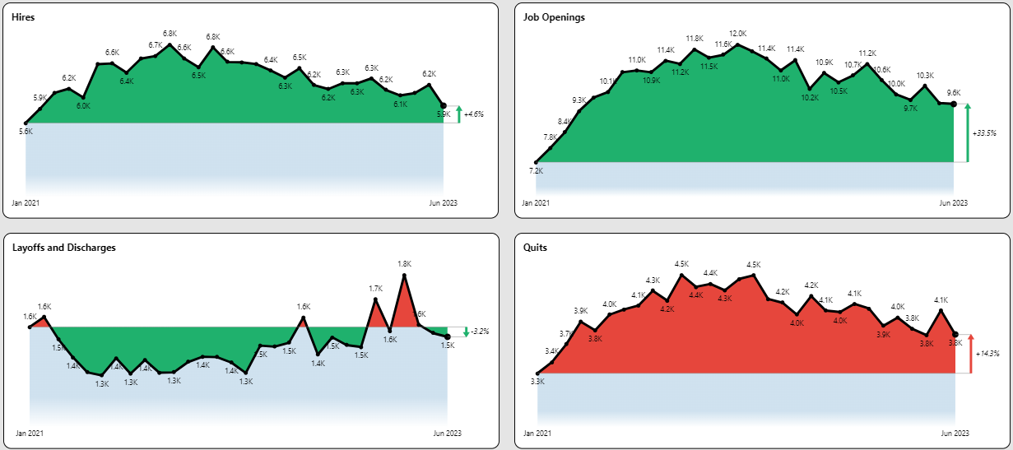
JOLTS Summary

Slide 3
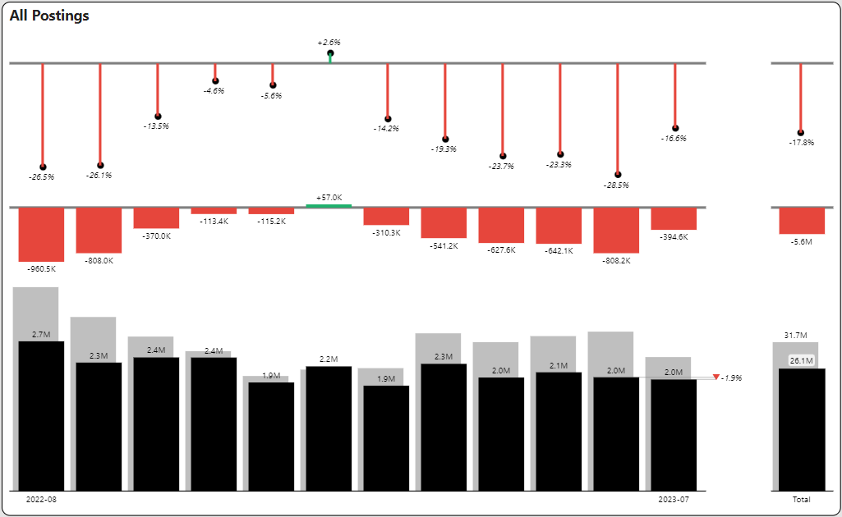
Posting Volume YoY and MoM Declines

Slide 4
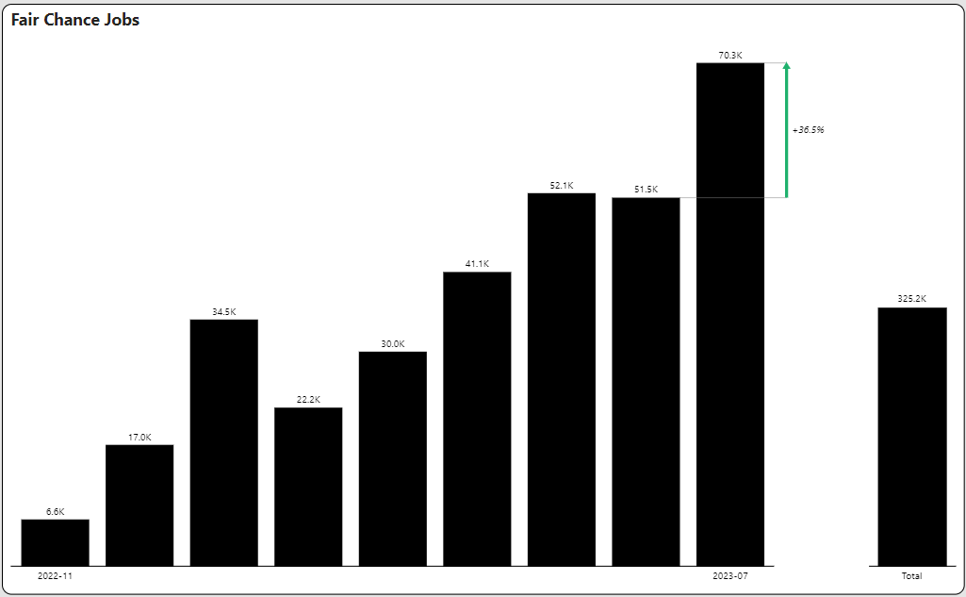
Fair Chance Jobs

Slide 5
Quarterly Posting Summary

Slide 6
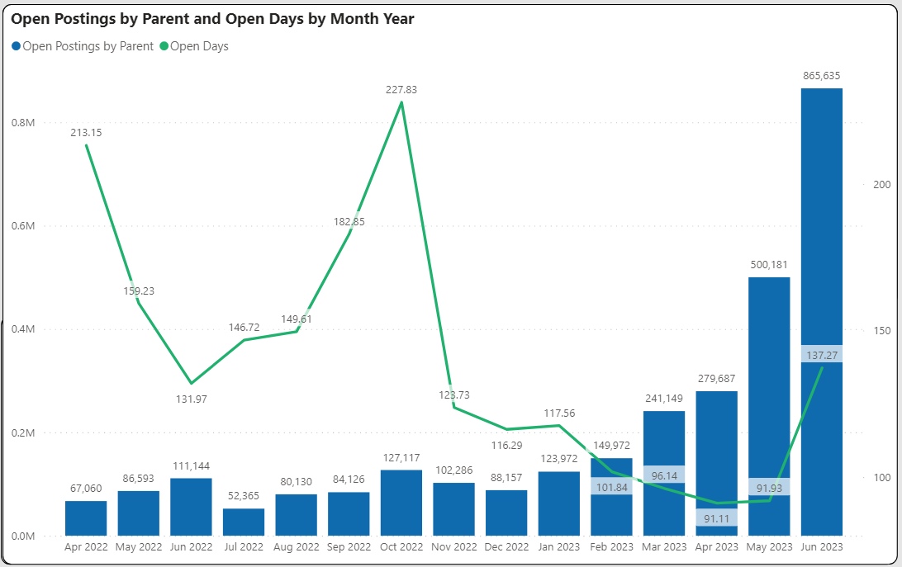
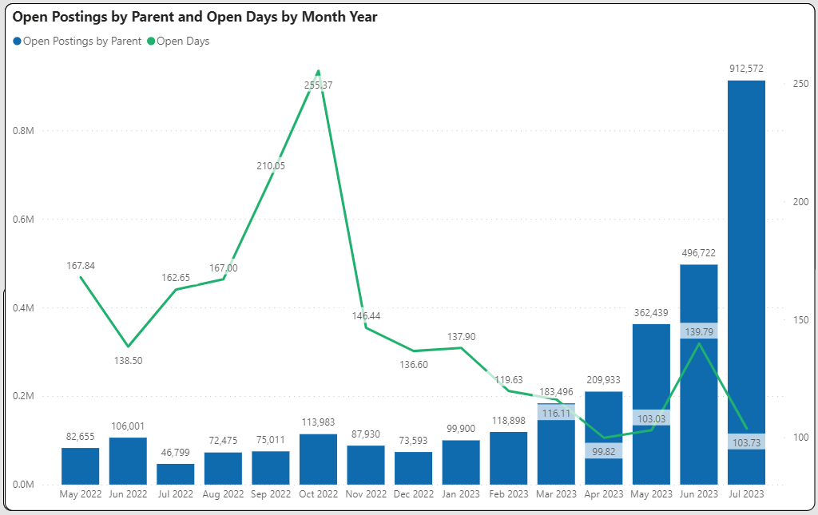
Open Posting Aging Trailing 15 Months

Slide 7
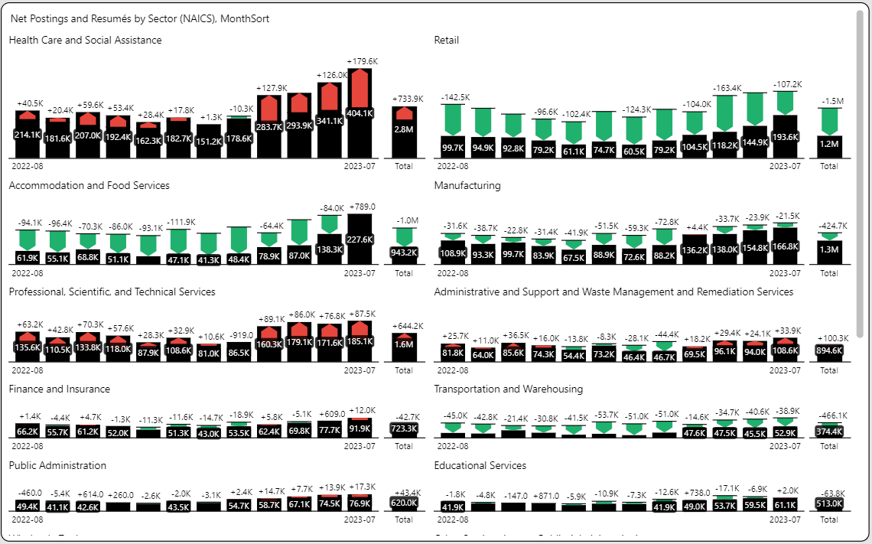
Selective Industry Supply/Demand Challenges

Slide 8
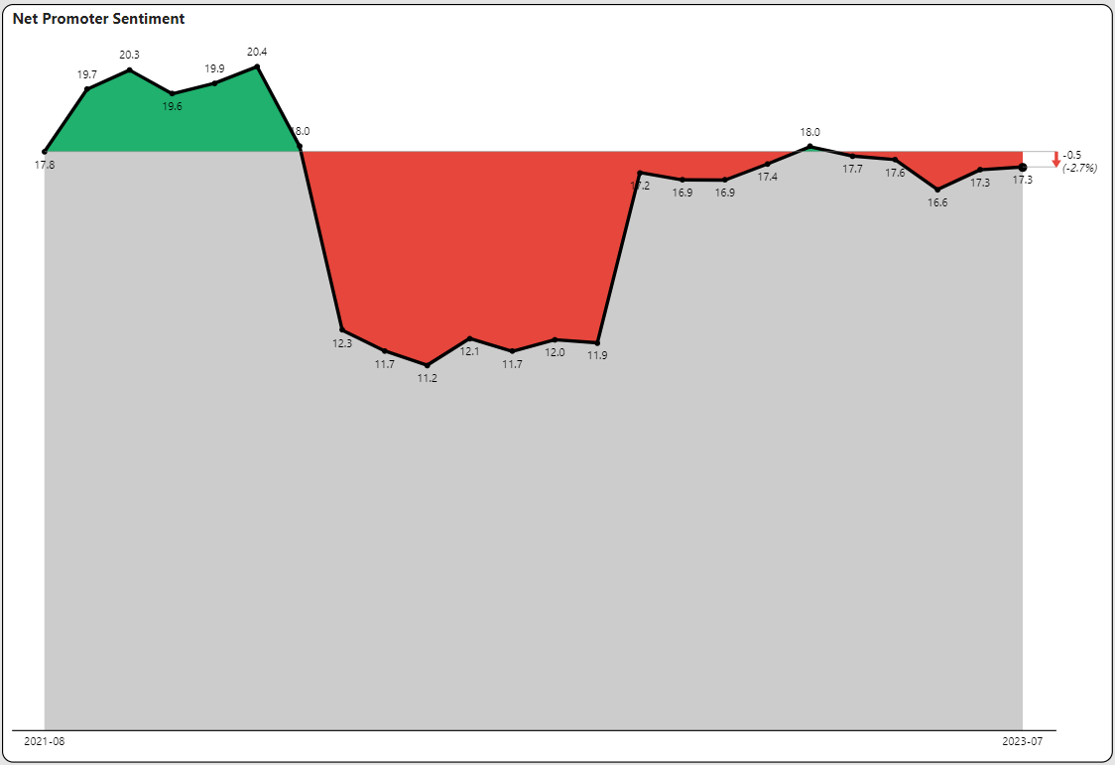
Net Promoter Scores Inching Back Up

Slide 9
How Can TalentView Help Your Company with Data-Driven Decision Making?
Schedule a personalized
discussion of your needs
Schedule Demo
GET IN TOUCH:
Dan.Quigg@publicinsight.io https://www.linkedin.com/in/danquigg/
VIEW WEBSITE:
www.PublicInsight.io

