Slide 1

U.S. Jobs Market – May Update
Sign up for our free service at https://publicinsight.io/research/us-jobs-report/.
June 12, 2023
Dan Quigg — CEO, Public Insight Data Corporation

Slide 2

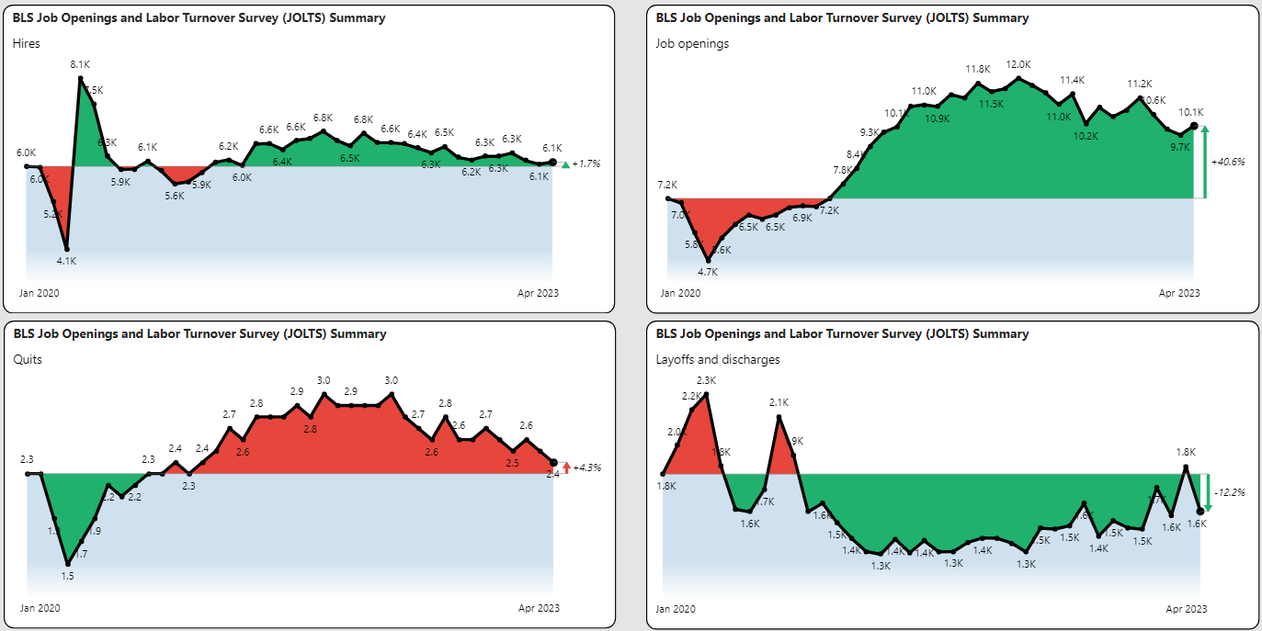
JOLTS Summary

Slide 3
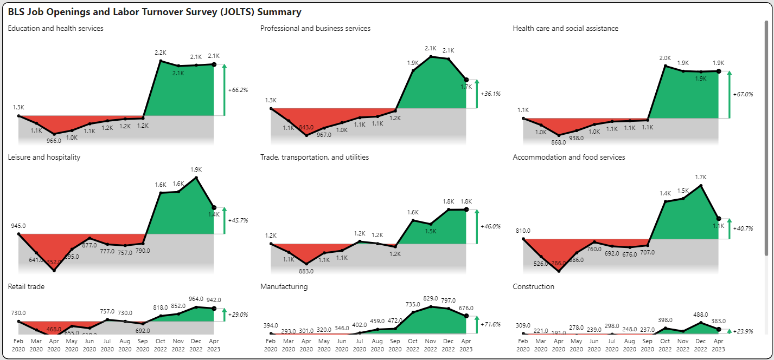
Job Openings Pre and Post Pandemic

Slide 4
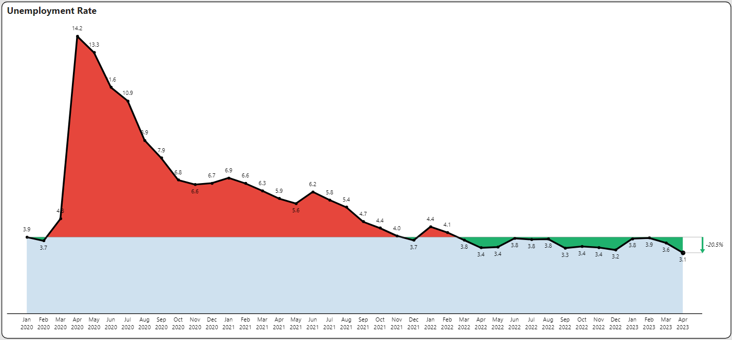
Unemployment Remains Near Historic Lows

Slide 5
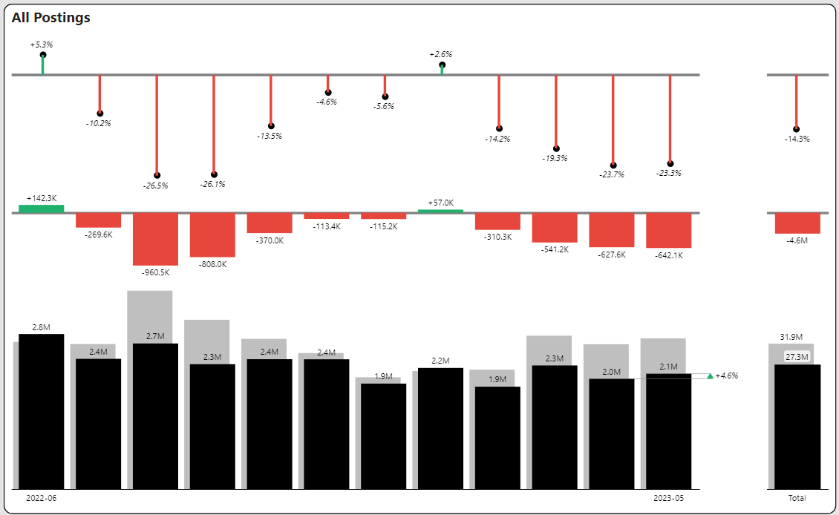
Posting Volume YoY Declines but Recent Gains

Slide 6
Quarterly Posting Summary

Slide 7
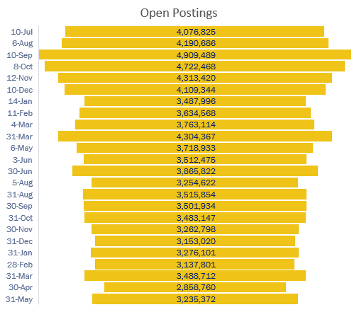
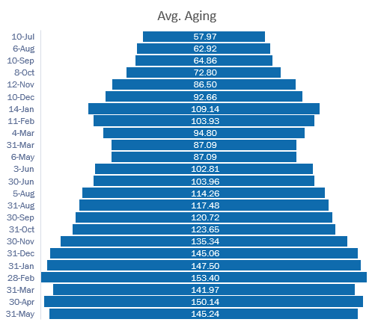
Open Posting Aging

Slide 8
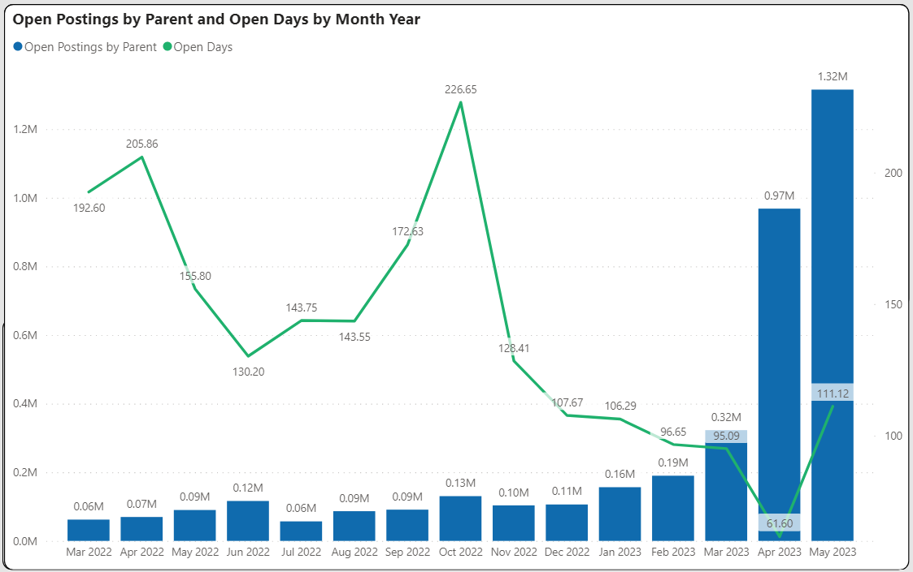
Open Posting Aging Trailing 15 Months

Slide 9
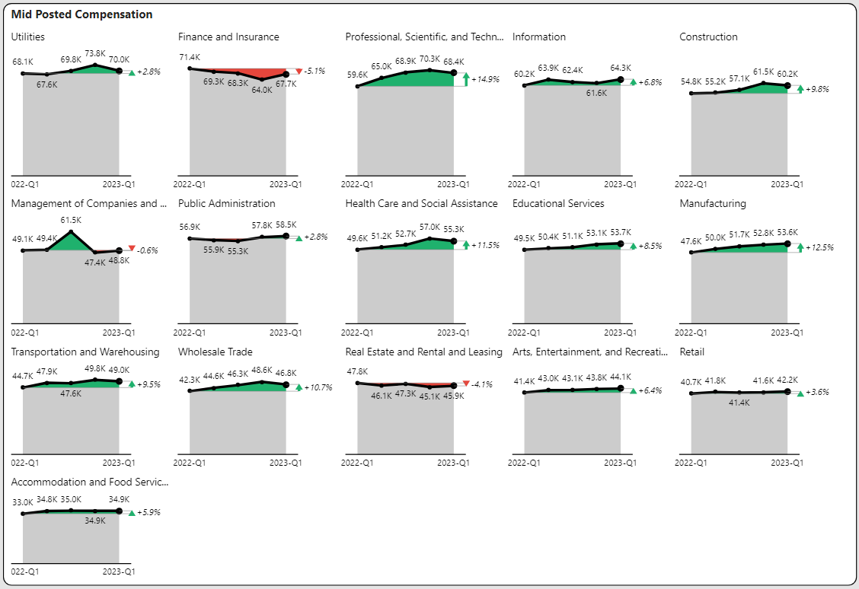
Compensation by Industry

Slide 10
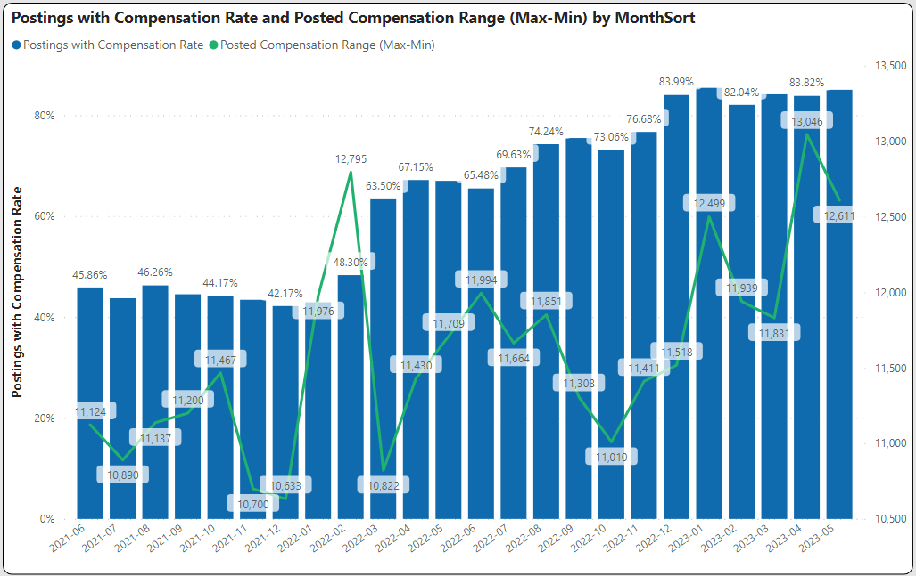
Pay Transparency is Here to Stay

Slide 11
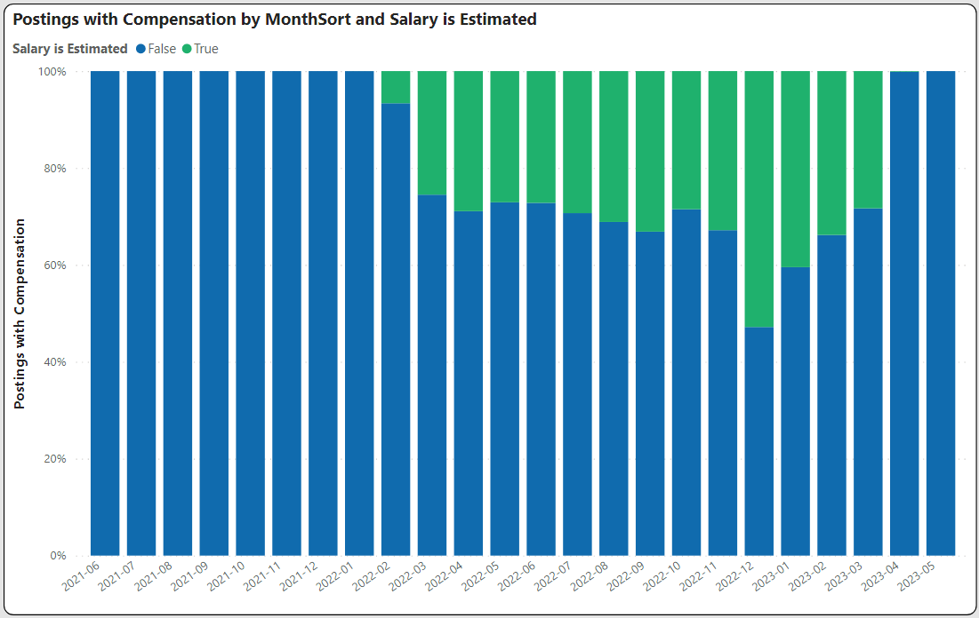
Employers are Increasingly Self-Disclosing
Indeed Push for Transparency

Slide 12
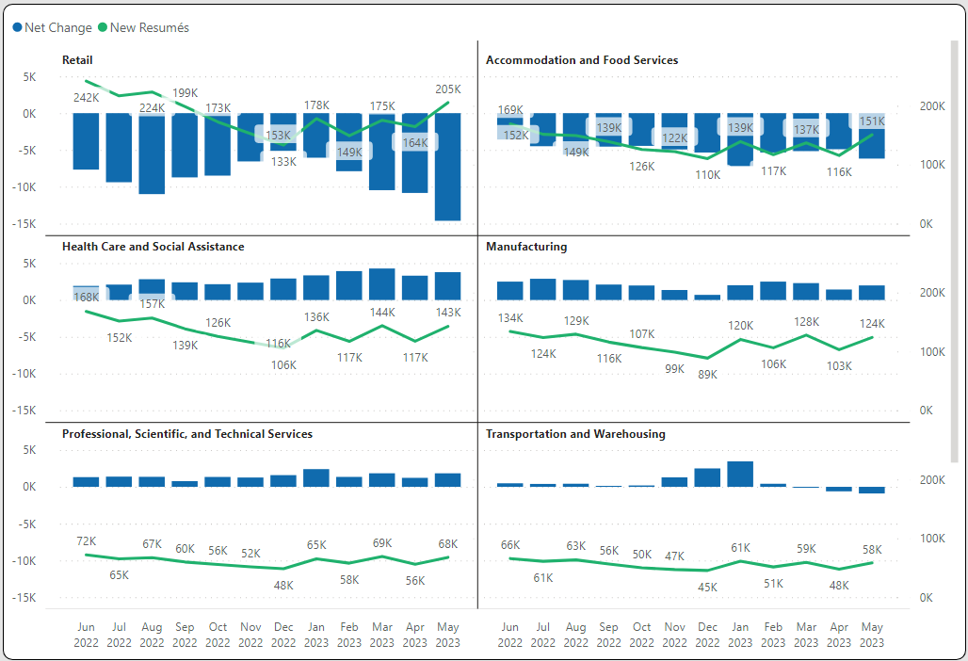
New and Changing Job Seekers

Slide 13
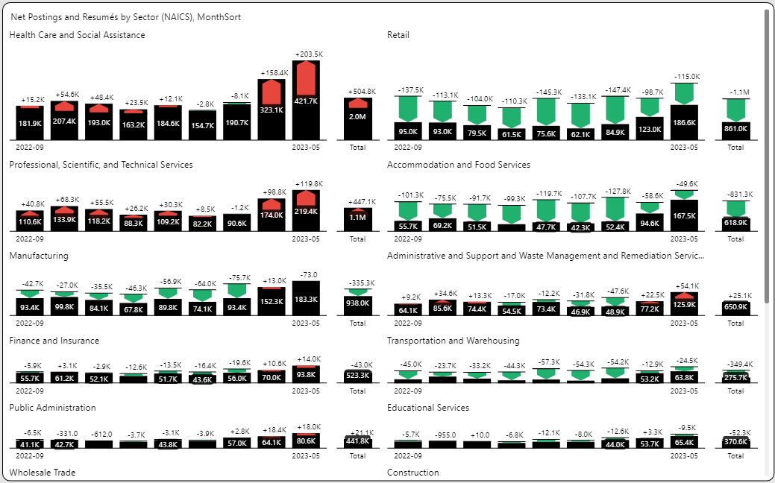
Selective Industry Supply/Demand Challenges
Includes improved job posting collection in April.

Slide 14

How Can TalentView Help Your Company with Data-Driven Decision Making?
Schedule a personalized
discussion of your needs
Schedule Demo
GET IN TOUCH:
Dan.Quigg@publicinsight.io
https://www.linkedin.com/in/danquigg/
VIEW WEBSITE:
www.PublicInsight.io

