Slide 1

U.S. Jobs Market – April Update
Sign up for our free service at https://publicinsightdata.com/research/us-jobs-report/.
May 12, 2022
Dan Quigg — CEO, Public Insight Data Corporation

Slide 2

Agenda
Labor Market Update
Posting Statistics
Workplace Satisfaction

Slide 3
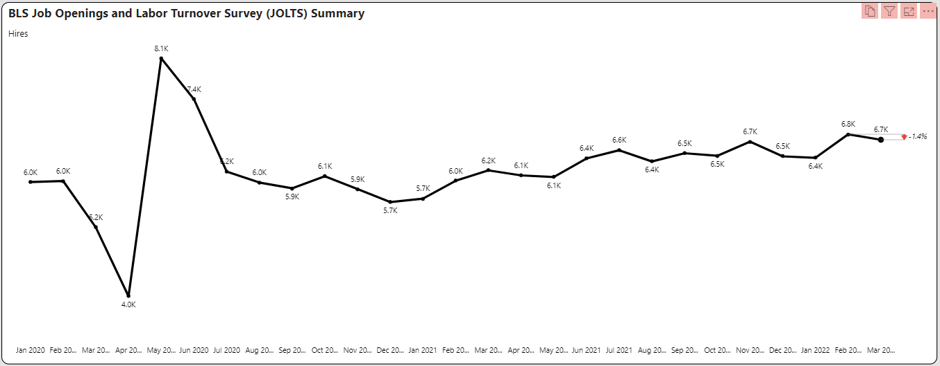
Hires Down

Slide 4
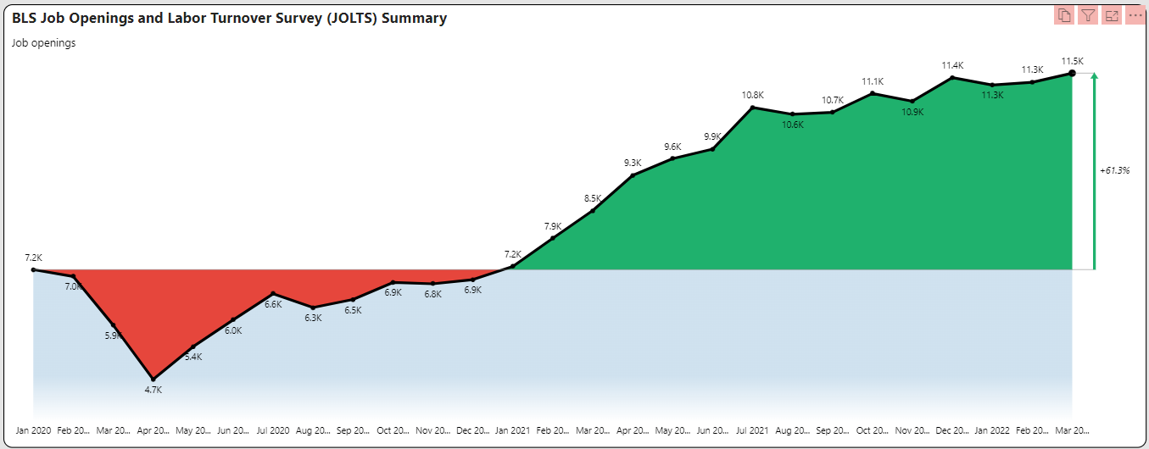
Openings Up

Slide 5
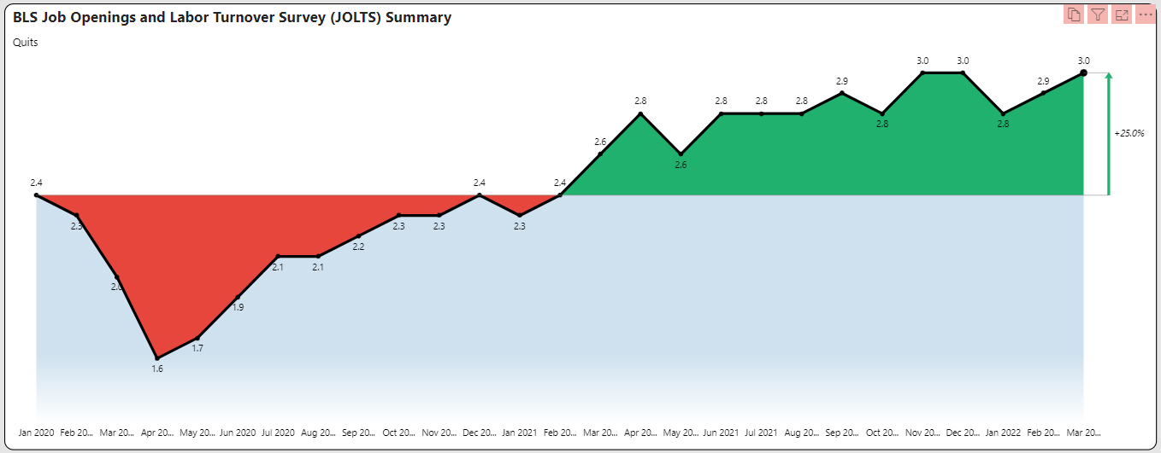
Quit Rates Bounce Back Up

Slide 6
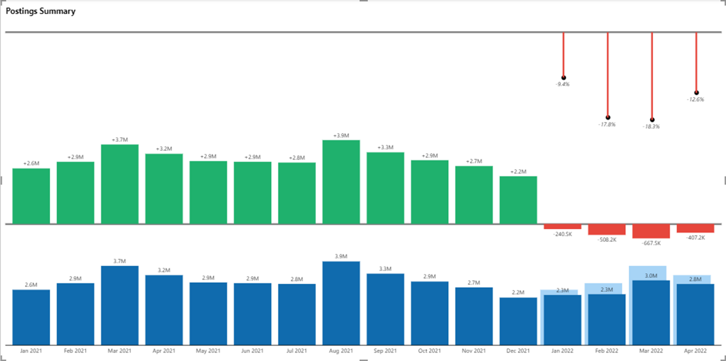
Posting Volume Trails 2021 Activity

Slide 7
Quarterly Posting Summary

Slide 8
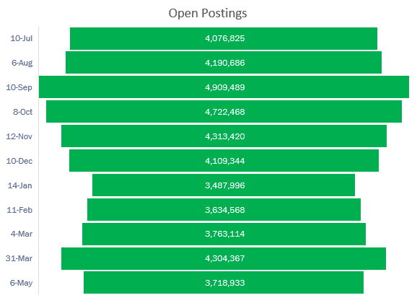
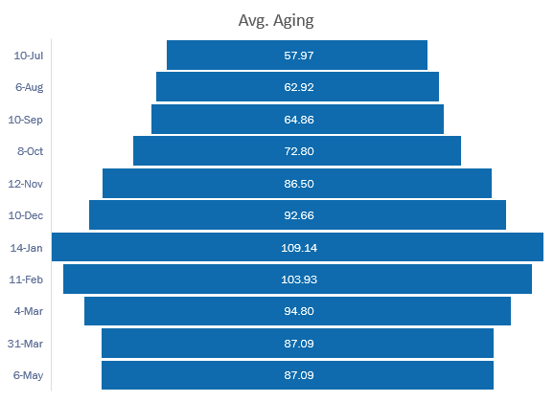
Open Posting Aging

Slide 9
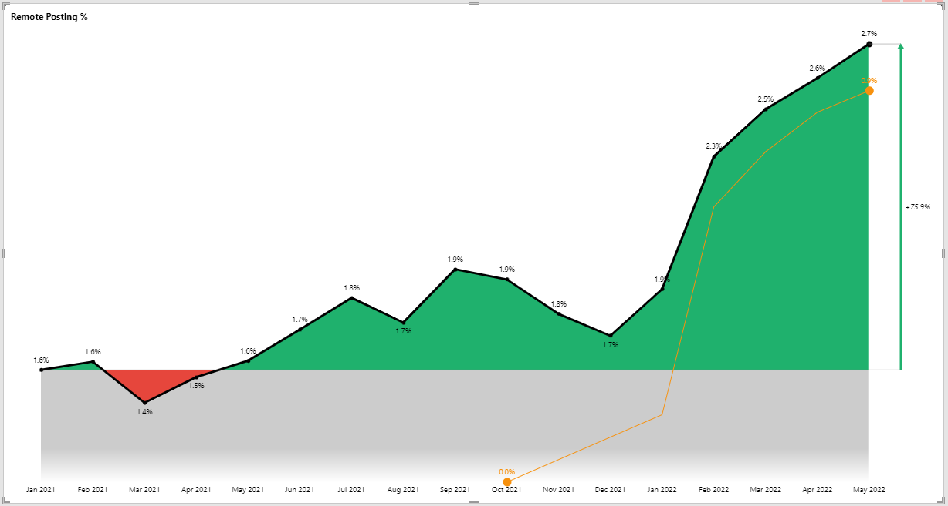
Remote Posting Trends
Permanent
Hybrid

Slide 10
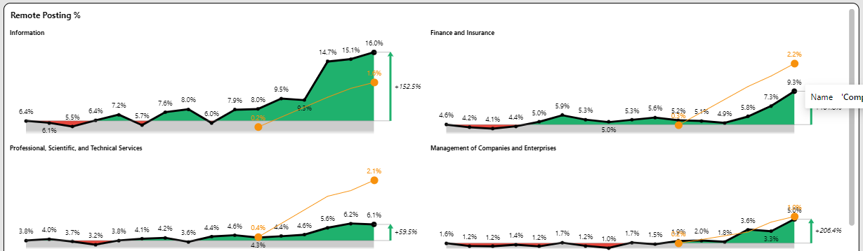
Industry Comparisons of Remote
Permanent
Hybrid

Slide 11
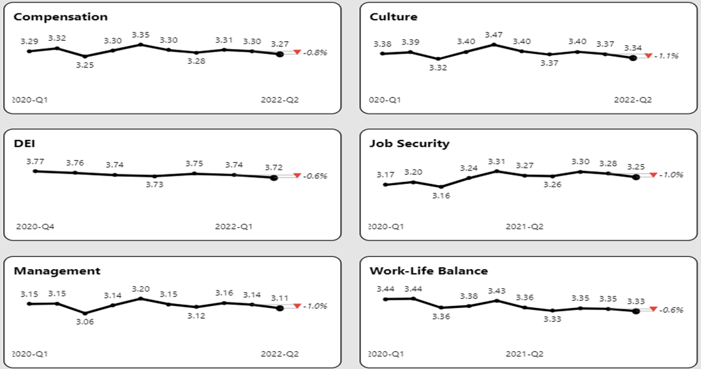
Ratings and Sentiment Continue Declines

Slide 12
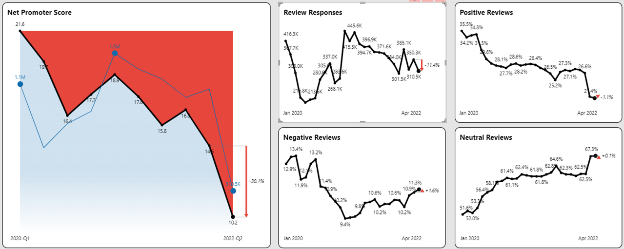
Review Sentiment Declines

Slide 13
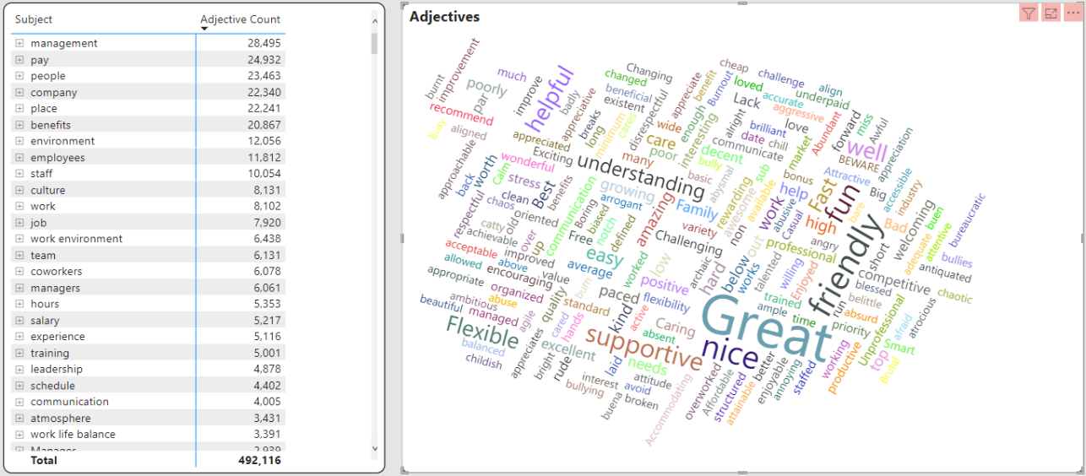
April Opinions

Slide 14

How Can TalentView Help Your Company with Data-Driven Decision Making?
Schedule a personalized demo
and discussion of your needs
Schedule Demo
GET IN TOUCH:
Dan.Quigg@publicinsightdata.com
https://www.linkedin.com/in/danquigg/
VIEW WEBSITE:
www.PublicInsightData.com

