Slide 1
U.S. Jobs Market – February Update
Sign up for our free service at https://publicinsightdata.com/research/us-jobs-report/.
March 10, 2022
Dan Quigg — CEO, Public Insight Data Corporation

Slide 2
New Whitepaper

Slide 3
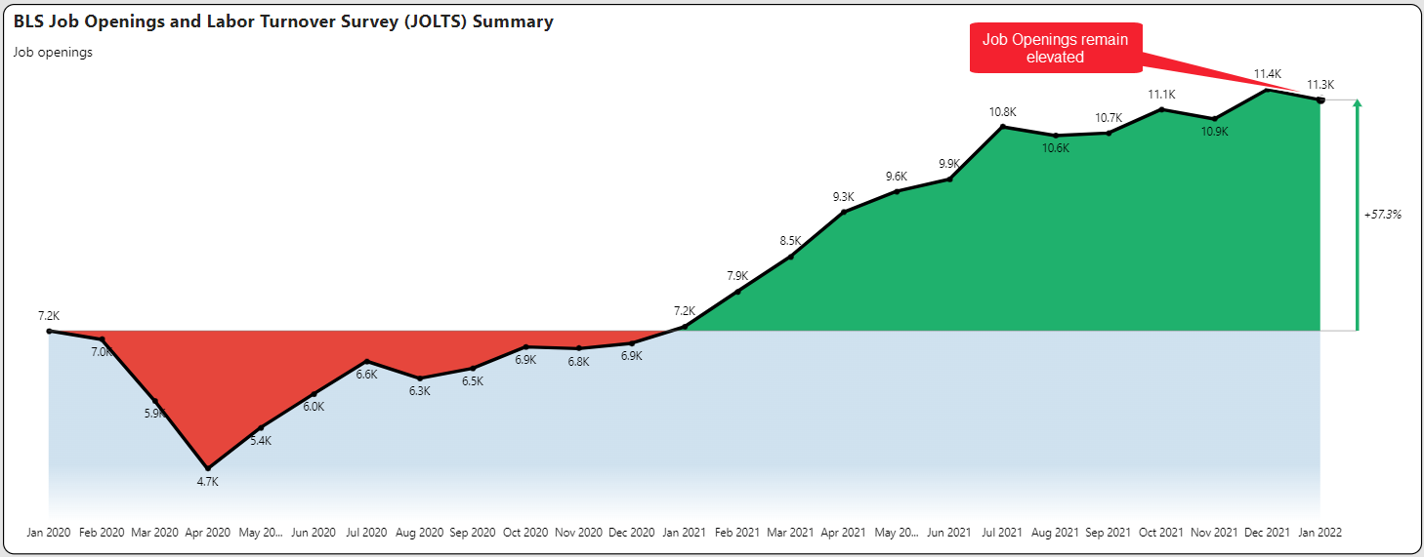
Quick Update on Labor Market

Slide 4
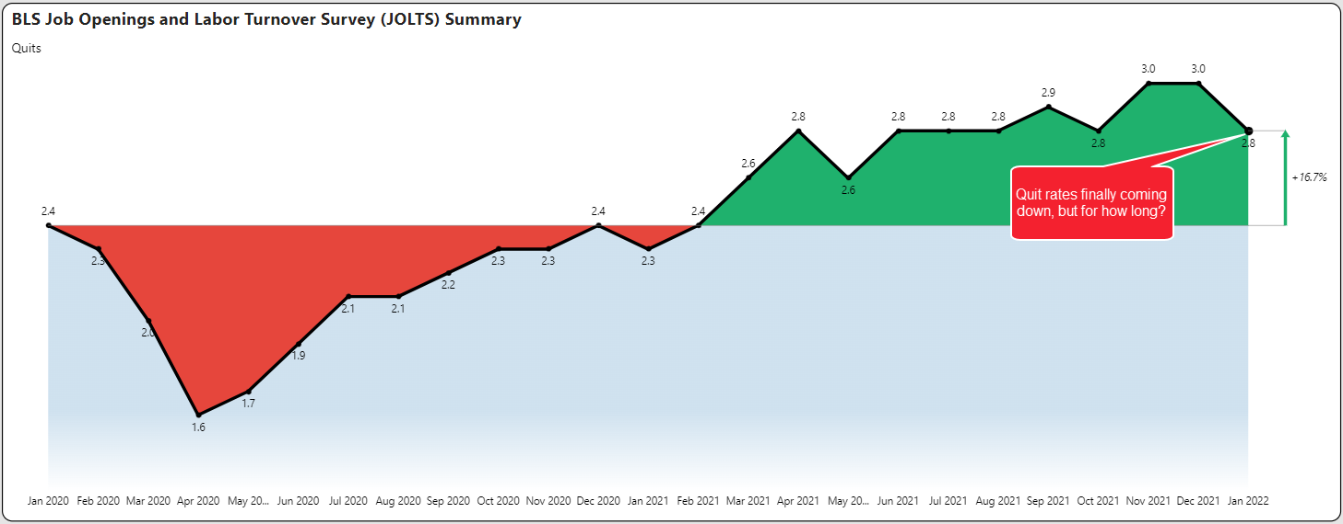
Quick Update on Labor Market

Slide 5
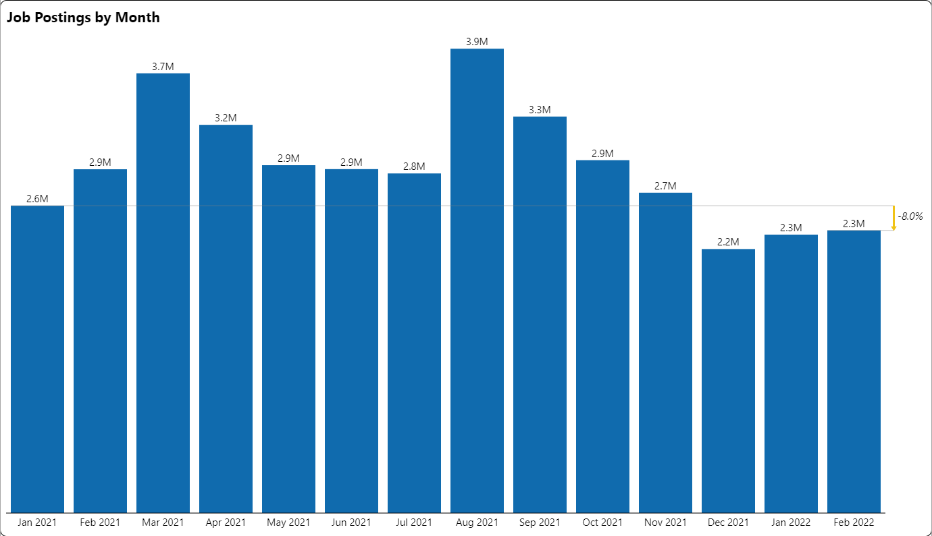
Slowing Posting Volume

Slide 6
Posting Summary (as of Mar. 4)

Slide 7
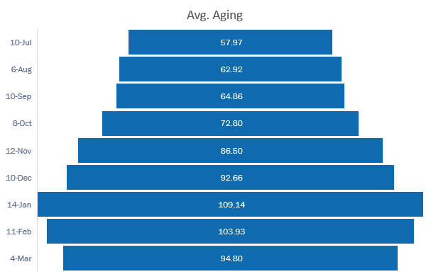
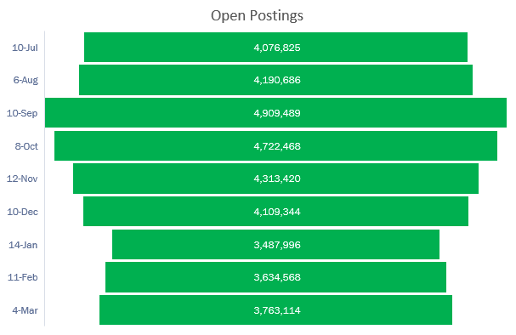
Open Posting Aging

Slide 8
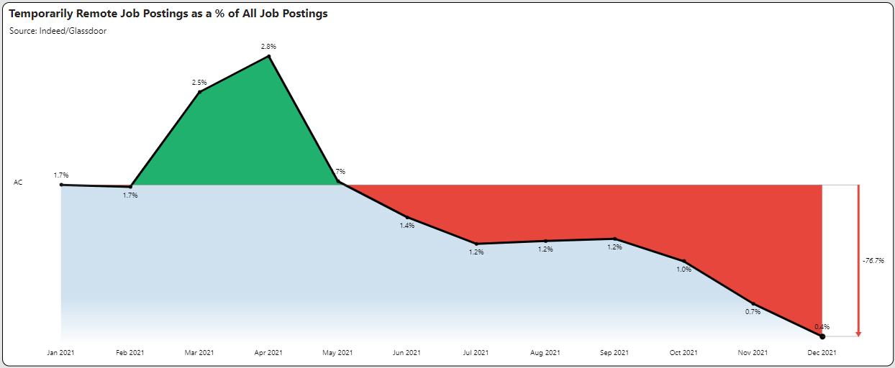
Remote Work Analysis
Temporary accommodations are being replaced by permanent.

Slide 9
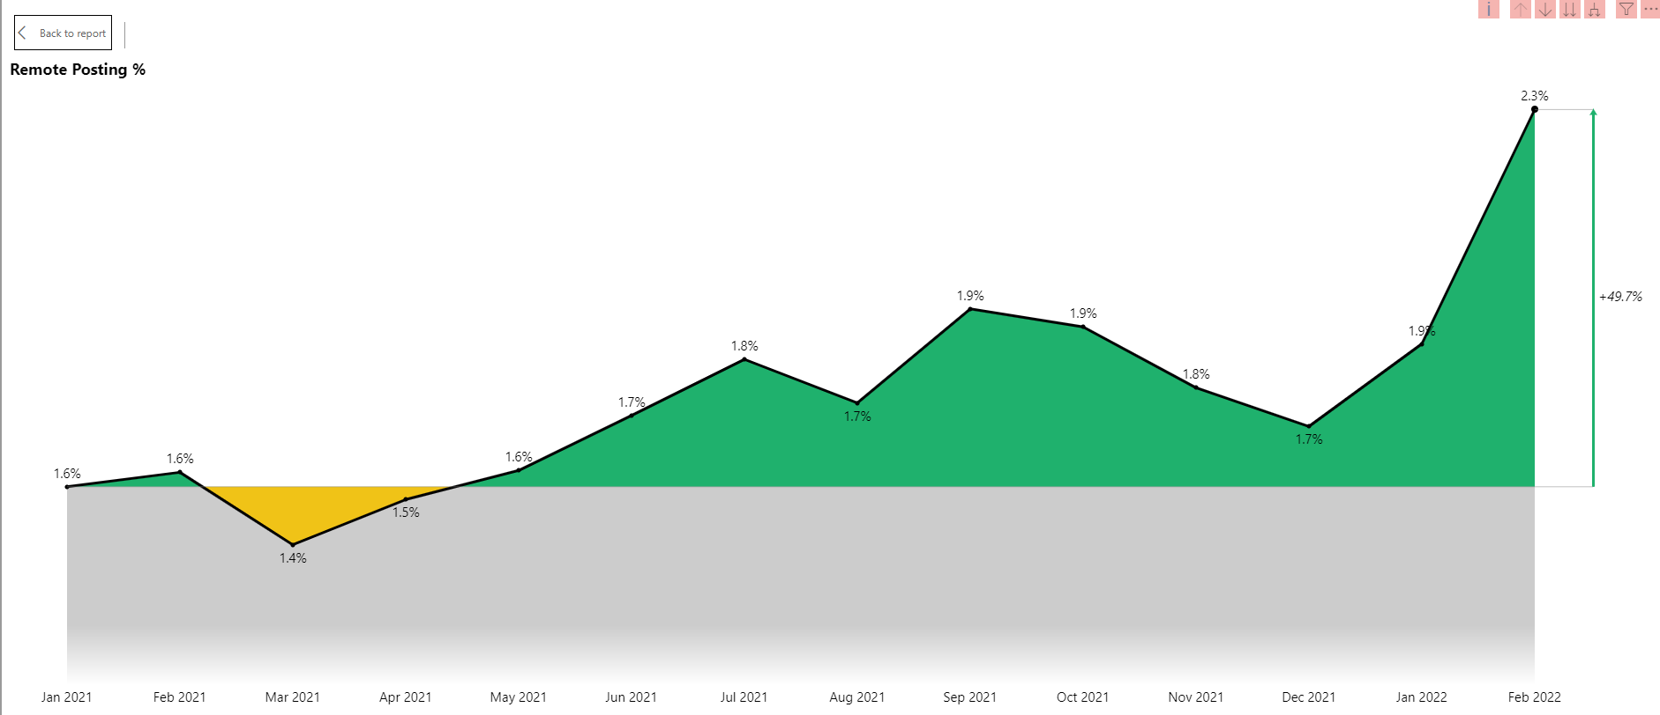
Remote Work Analysis
Permanent remote categories have resumed strong growth. In addition, Indeed has introduced a new “hybrid remote” category.

Slide 10
How Can TalentView Help Your Company with Data-Driven Decision Making?
Schedule a personalized demo and discussion of your needs
Schedule Demo
GET IN TOUCH:
Dan.Quigg@publicinsightdata.com https://www.linkedin.com/in/danquigg/
VIEW WEBSITE:
www.PublicInsightData.com

